Slide 1
Bitcoin Closing Price Prediction Model
Notes:
The second model I built is that of the closing price prediction of Bitcoin. I started investing in cryptocurrency about a year ago, and I noticed that the price fluctuations are unpredictable. In order to maximize my profit, I wanted to understand how this market works and if we can predict the prices of these cryptocurrencies. Since Bitcoin is one of the oldest cryptocurrencies, it had more amounts of data and hence would give a more accurate model. This model can eventually also be used by potential investors and help them increase their profit margins.

Slide 2
Business/Data Understanding
Contents
Contents
Business Purpose
Financial consulting firm that provides analysis and insights to big financial investors.
Aim to build the best fitting model in order to find the most accurate predicted future closing prices of Bitcoin.
Data Understanding/Preparation
Original data: 10 columns, 73000 observations
Filtering:
Bitcoin filtered as the crypto name (3.2k observations)
Dropped columns (Date, timestamp, crypto_name)
DS Salary Model
Bitcoin Model
Spotify Visualization
Notes:
The data that I obtained contained all of the cryptocurrencies till 2022 and hence needed to be filtered out. Also certain date time columns were dropped as they weren’t relative to the model.

Slide 3
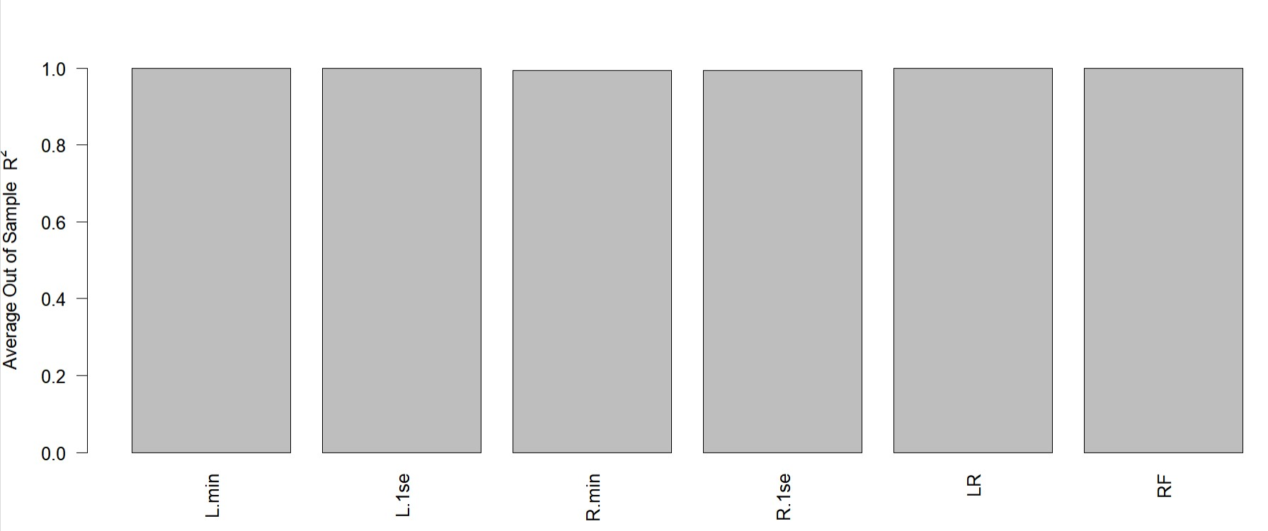
Modeling/Results
Contents
Regression Model: predict the salary for each job candidate
Linear Regression
Linear Regression with Interactions
Lasso.min
Lasso.1se
Ridge.min
Ridge.1se
Random Forest Model
Results: The linear regression model gave the highest Out of Sample Accuracy which was around 0.9998. Therefore this model was chosen to predict the future closing prices of Bitcoin.
Notes:
For the model, I tested 6 models namely, linear regression, lasso.min, lasso1.se, ridge.min, ridge.1se and random forest model and the results showed that all of these models had above 0.9 out of sample accuracy but the linear regression model showed an accuracy of 0.9998. Therefore this model was chosen to predict the closing prices of Bitcoin

